Slide 1


SEO Video Optimizer
AI-Powered YouTube SEO
Revolution
Transforming the Future

Slide 2



02
Basic Understanding
Problem Overview
Solution
Market Opportunity
Content creators struggle with manual keyword and hashtag selection.
Lack of tools for automated SEO optimization for videos.
Time-consuming and affects content visibility.
AI-powered tool analyzes video/audio for relevant keywords and hashtags.
Generates SEO-optimized descriptions automatically.
Enhances discoverability and saves time.
Growing demand for SEO tools in the creator economy.
Rising competition among digital marketers and influencers.
Scalable solution to address future market trends.

Slide 3




03
Main Components
Frontend(React/Tailwind)
AI Models
Backend(FastAPI)
Features: User authentication, file upload interface, keyword/description display.
Communication: Sends files and form data to the backend and receives responses with SEO-optimized data.
BART: Used for text summarization and keyword generation.
YouTube API Integration: Ranks keywords based on their relevance and performance on the platform.
Endpoints: Handles video uploads, audio extraction, text conversion, and keyword generation.
Functions:
upload_video: Validates and stores uploaded videos.
video_to_wav: Converts video files to audio files.
wav_to_text: Transcribes audio to text.
generate_keywords_with_bart_and_seeds_using_youtube: Creates SEO keywords and ranks them using AI models like BART.
Communication: Listens for HTTP requests from the frontend, processes video data, and responds with keywords and SEO suggestions.
Uploaded Files: Stored on the server in the uploaded_videos directory.
Generated Keywords: Potentially saved in a database for future analytics and user access.
Data Storage

Slide 4



04
Data Structures Used
Lists & Dictionaries
DataBase
Files
Seed keywords are processed as lists.
Output keywords and SEO ranks are returned as dictionaries.
.mp4, .wav, and .txt files for input and intermediate processing.
User data, subscription details, and keyword generation history.

Slide 5







Keyword Generation
05
Text to Keyword Extraction
Text Summarization
using LLM
Integrating KeyBert with LLM
SEO Ranking for Keywords
Video
Dowload
Video to Audio
Audio to Text
yt-dlp Library: yt-dlp to download videos from YouTube efficiently
Summarize the extracted text using large language models (LLMs) like BART or LLaMA
YouTube API: Utilize the YouTube API to analyze and rank keywords based on SEO metrics to optimize video visibility
Transcribe audio files to text with the SpeechRecognition library
Convert downloaded video files to audio format using the moviepy library for easy audio processing.
Extract relevant keywords from the transcribed text using keyBERT
Combine the keywords generated by KeyBERT with LLM outputs to refine

Slide 6
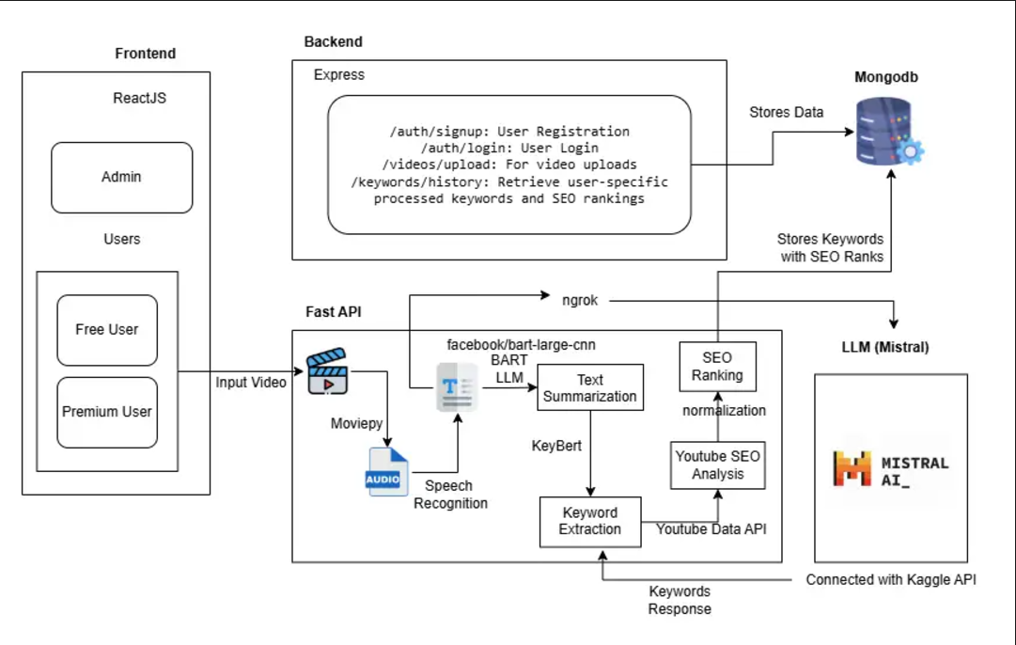
ARCHITECTURE DIAGRAM
06

Slide 7



07
Selling Point
Limited number of content uploads (e.g., 3 per day)
Basic keyword suggestions and hashtags
Ads displayed in the user interface
Unlimited uploads and access to advanced keyword suggestions
Ad-free experience
Access to priority customer support
Analytics and performance insights for keywords

Slide 8



08
Roles in App
Free Users
Premium Users
Admin
Manage user subscriptions, monitor service performance.
Limited video uploads and basic keyword suggestions.
Unlimited uploads, advanced suggestions, analytics, and ad-free experience.

Slide 9




09
Interfaces To Develop
Login/Signup Interface: For user authentication.
Output Screen: Display generated keywords, hashtags, and SEO scores.
Admin Dashboard: Manage user accounts and monitor tool usage.

